Slide 1
Designing a POCKET ORGAN 设计一款口袋乐器
A mobile, chord-based, easy-to-learn instrument.
已和弦为主，易上手的随身乐器。
Thomas TEMPÉ 唐沛
2021-11-19

Slide 2
How many people play music?
How long does it take to learn your 1st song on a guitar?
Teach a volunteer to play a chord on a guitar
It’s difficult, painful…

Slide 3
Desirable attributes 期望特性
便携性
音域

Slide 4
Musical instruments Desirable attributes 乐器的期望特性

Slide 5
Musical instruments Desirable attributes 乐器的期望特性

Slide 6

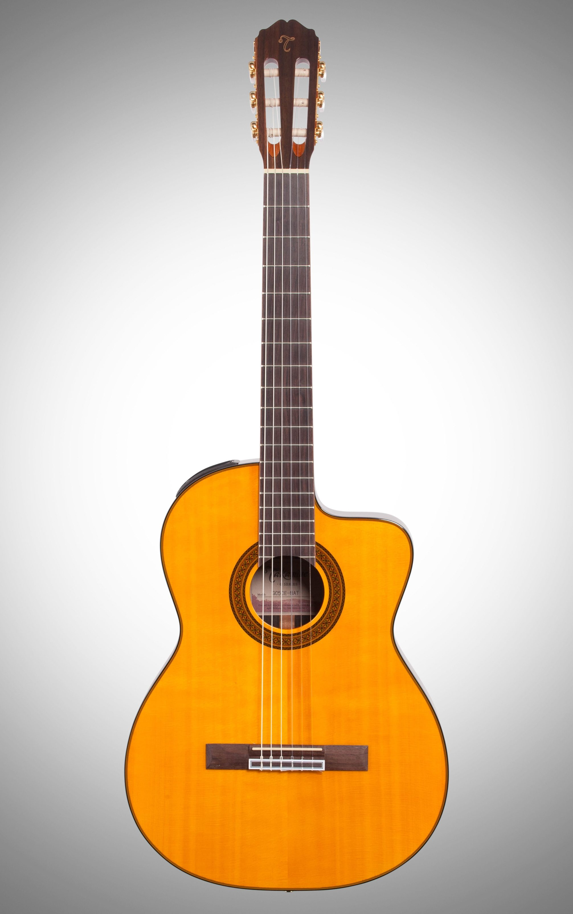
Ease of learning in the 21st century
vs.
Year 2000
Year 1850

Slide 7

Demo!

Slide 8
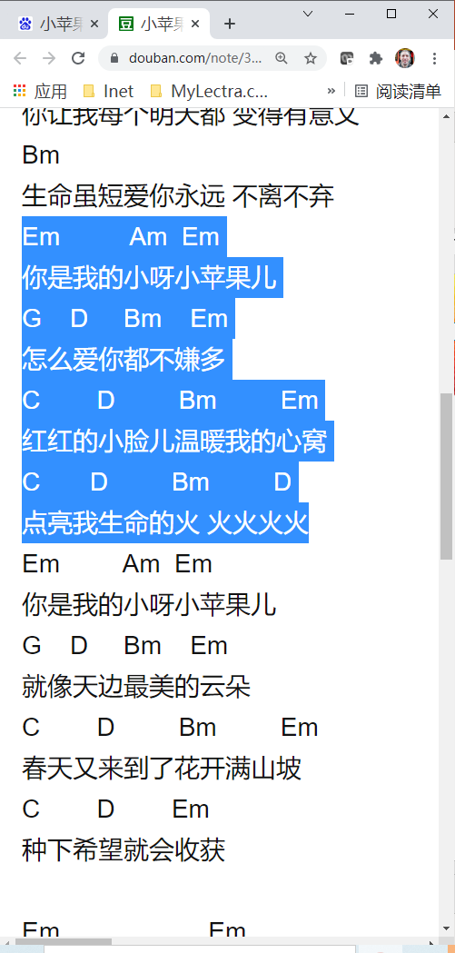
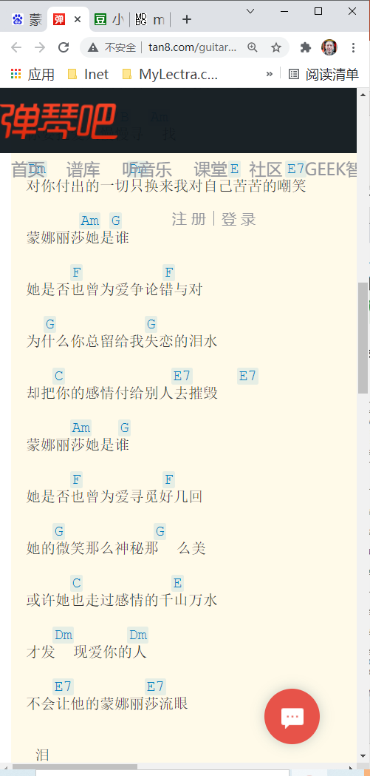
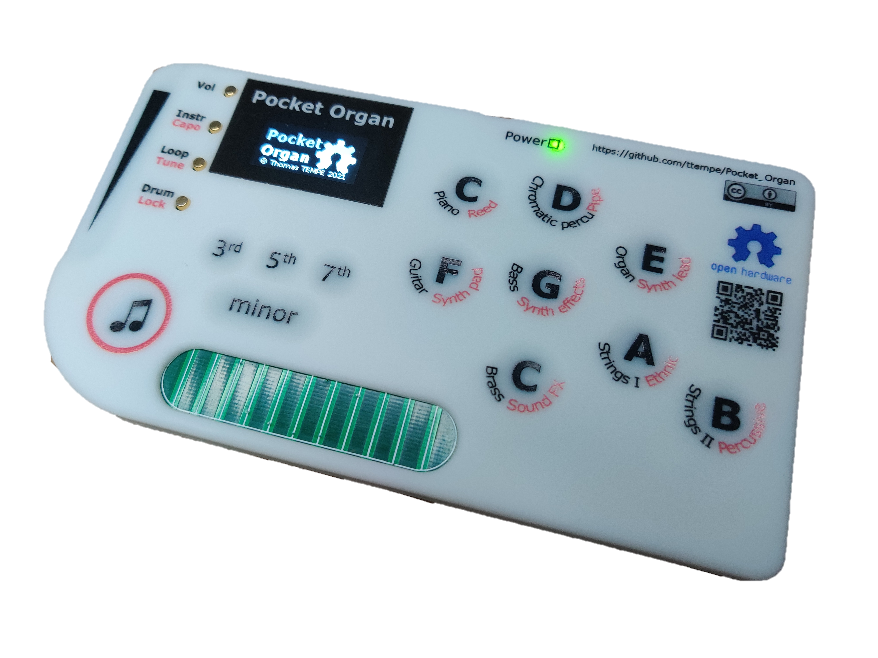


Getting started
Easily lookup guitar chords 直接搜寻歌曲的 吉他和弦谱

Slide 9
Project objectives
Ambition:
Develop the perfect product
Find someone to make and sell 1 000 000 of them
Low price (Design To Cost, Design For Manufacturing)
Open Source
An instrument, not a toy

Slide 10
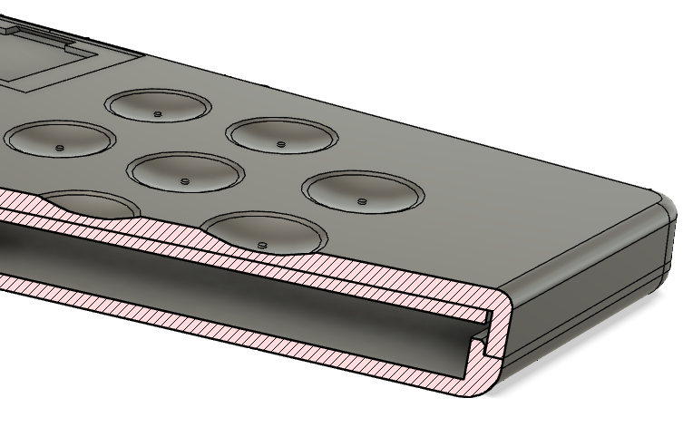
desigN GOALS
UI Design
Ergonomics
Progressive discovery
Visual feedback
User Experience Design
A step-by-step journey into music
Simple chords
Drum pad, melody
Strumming
Advanced chord shapes
Melody on top of a chord
Beat/bass line/melody/chords (loops)
Expression

Slide 11
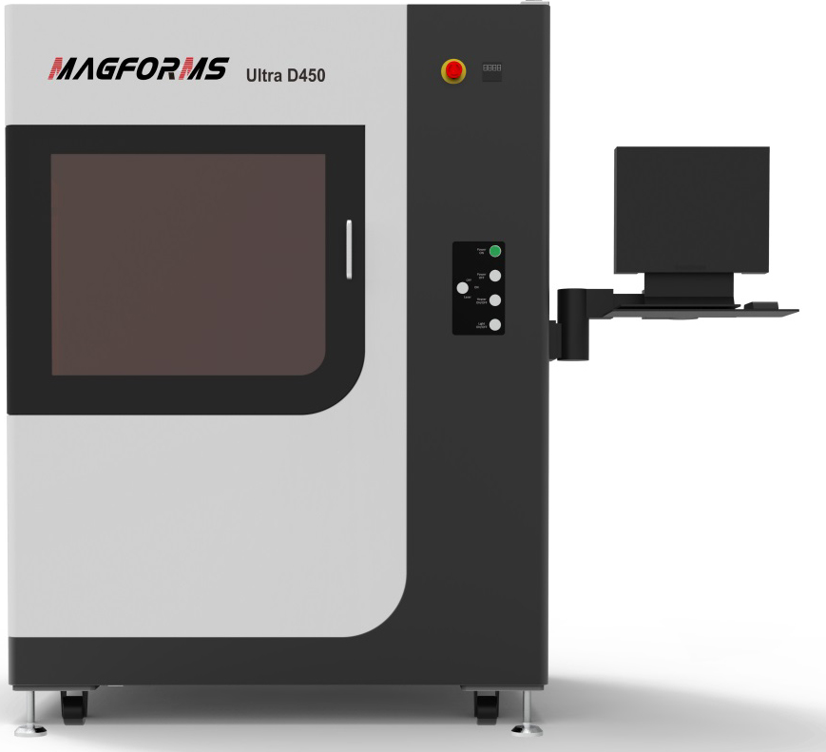
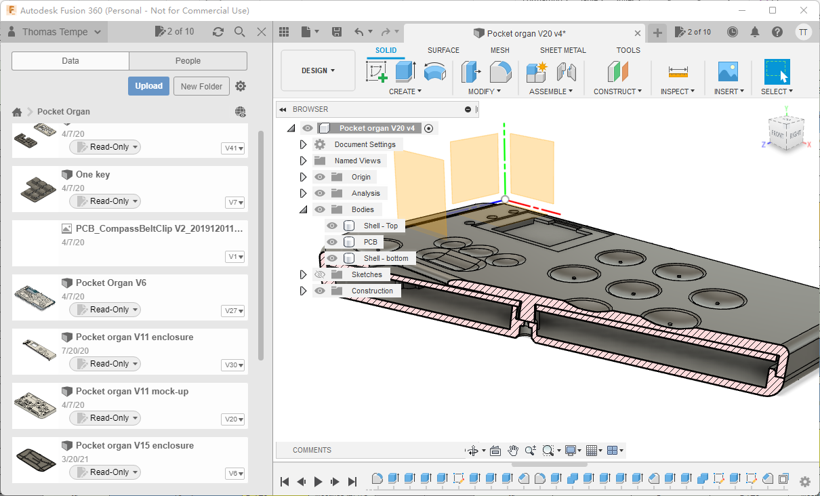
Toolchain: enclosure

Slide 12
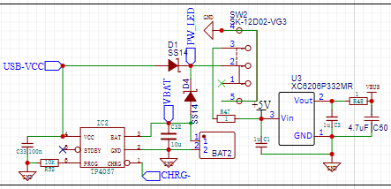
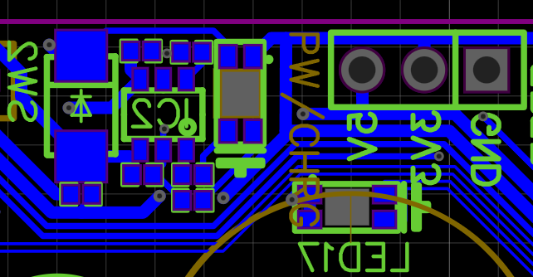
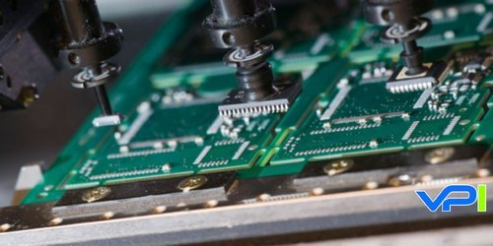
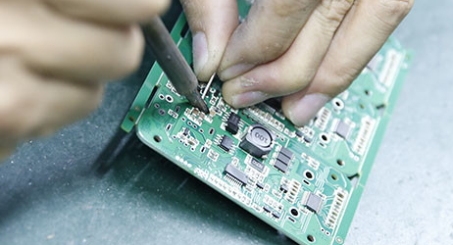
Toolchain: PCB

Slide 13
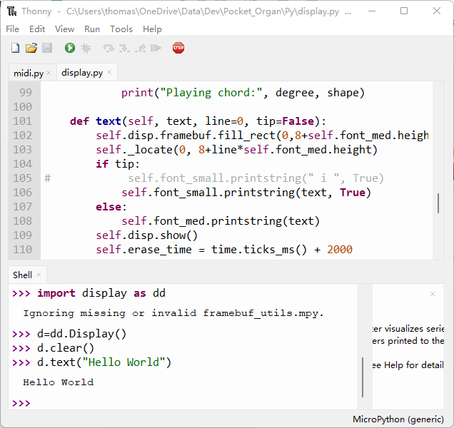
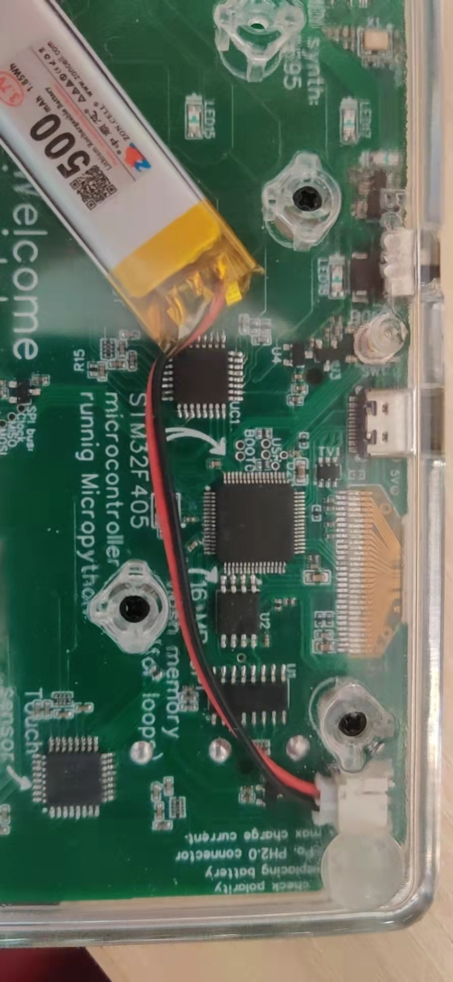
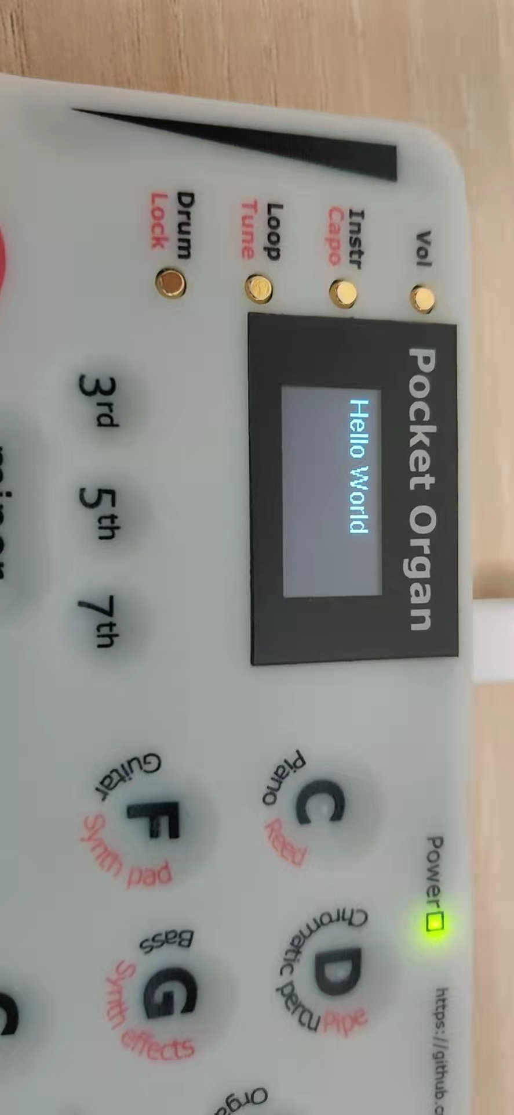

Software development

Slide 14
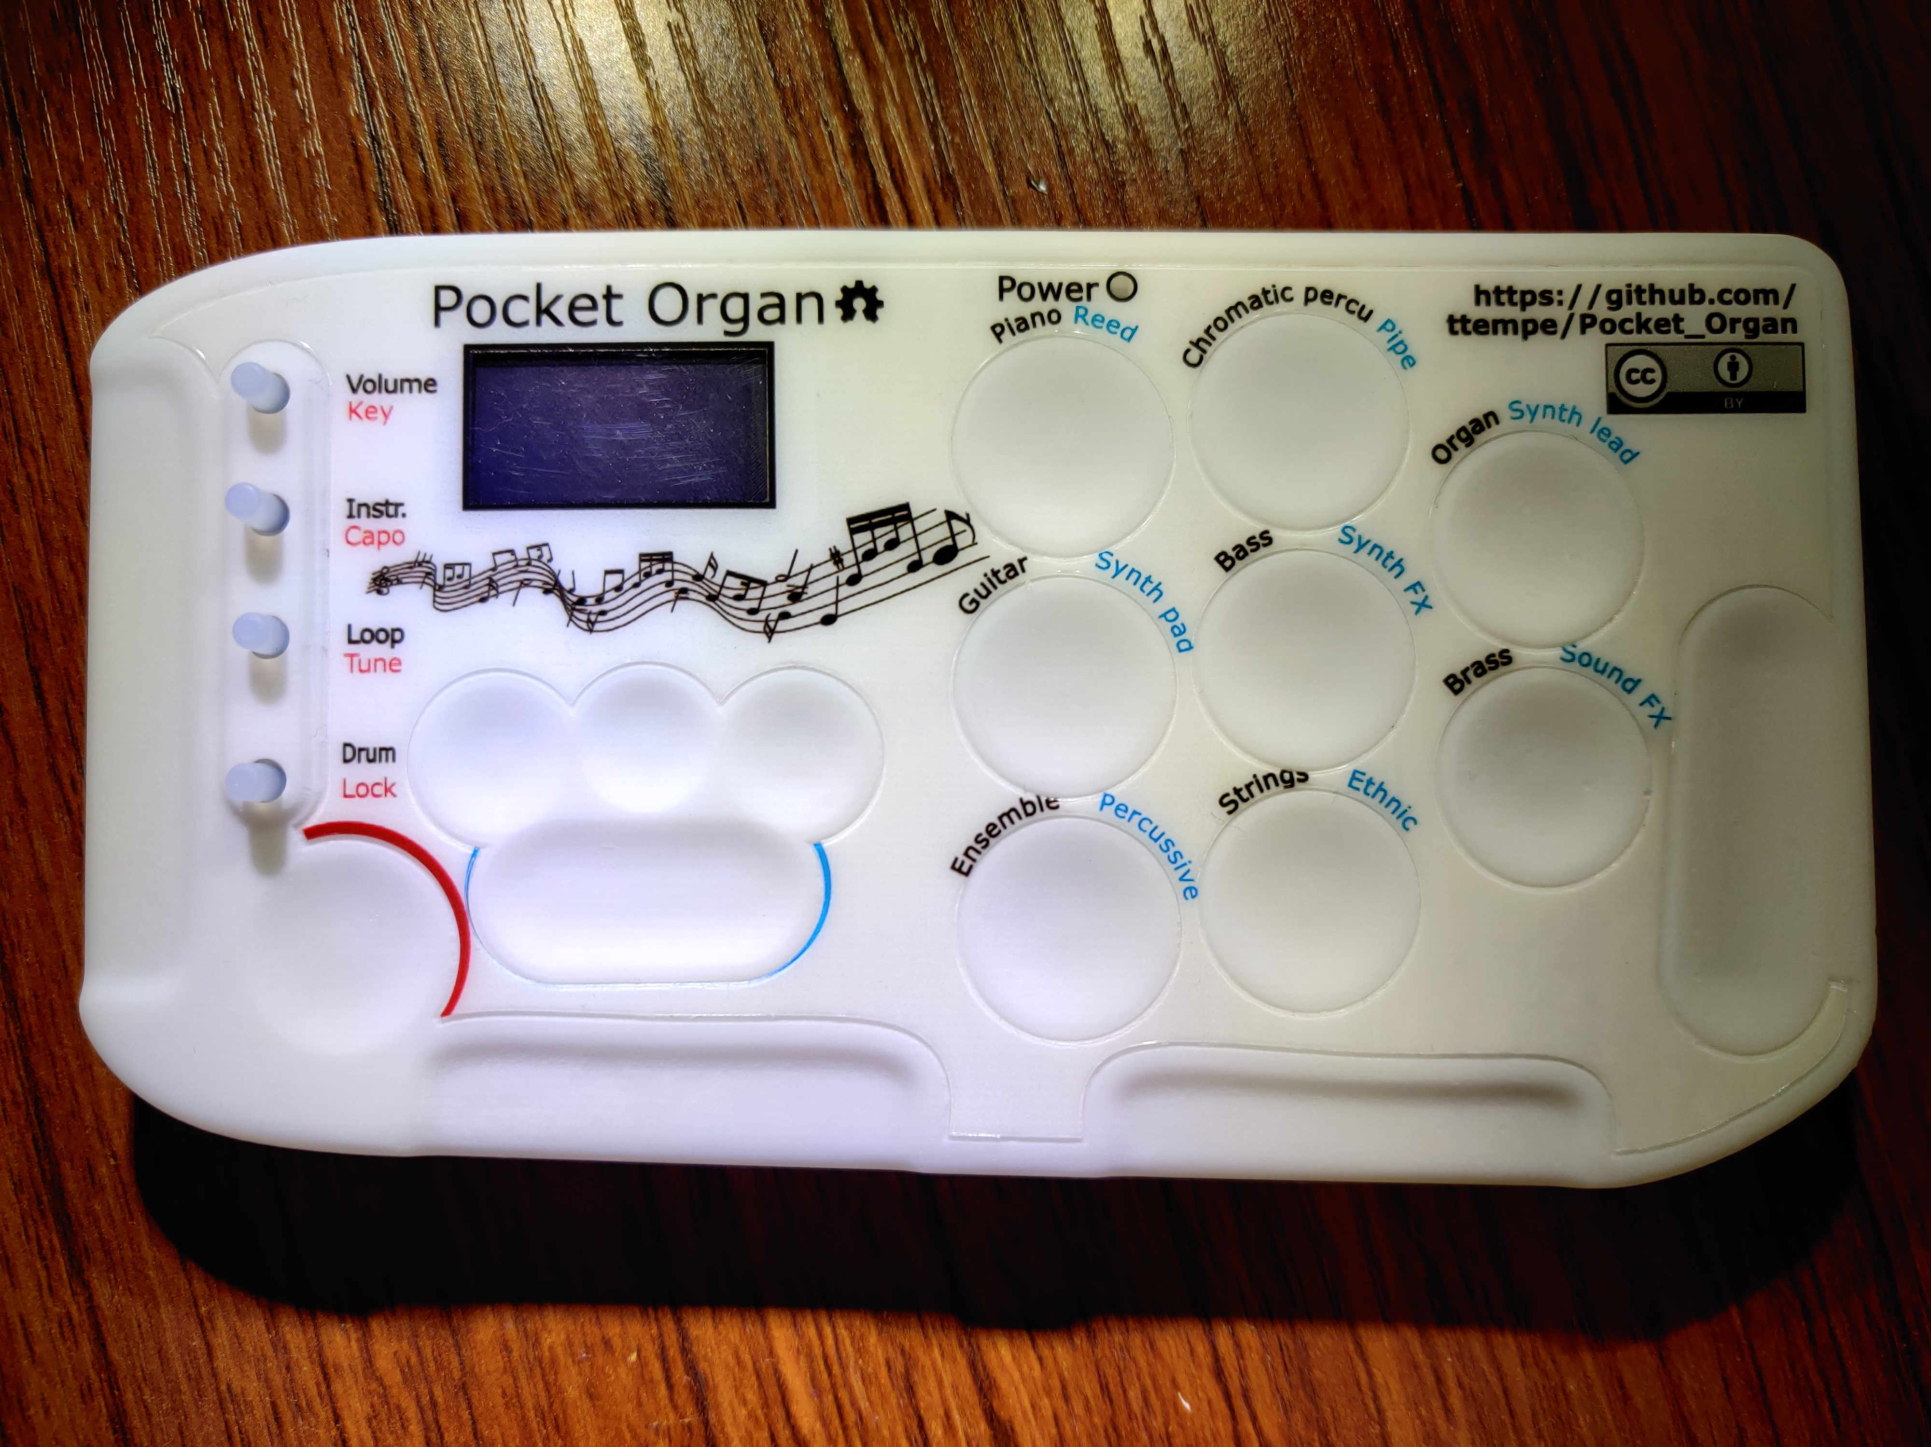
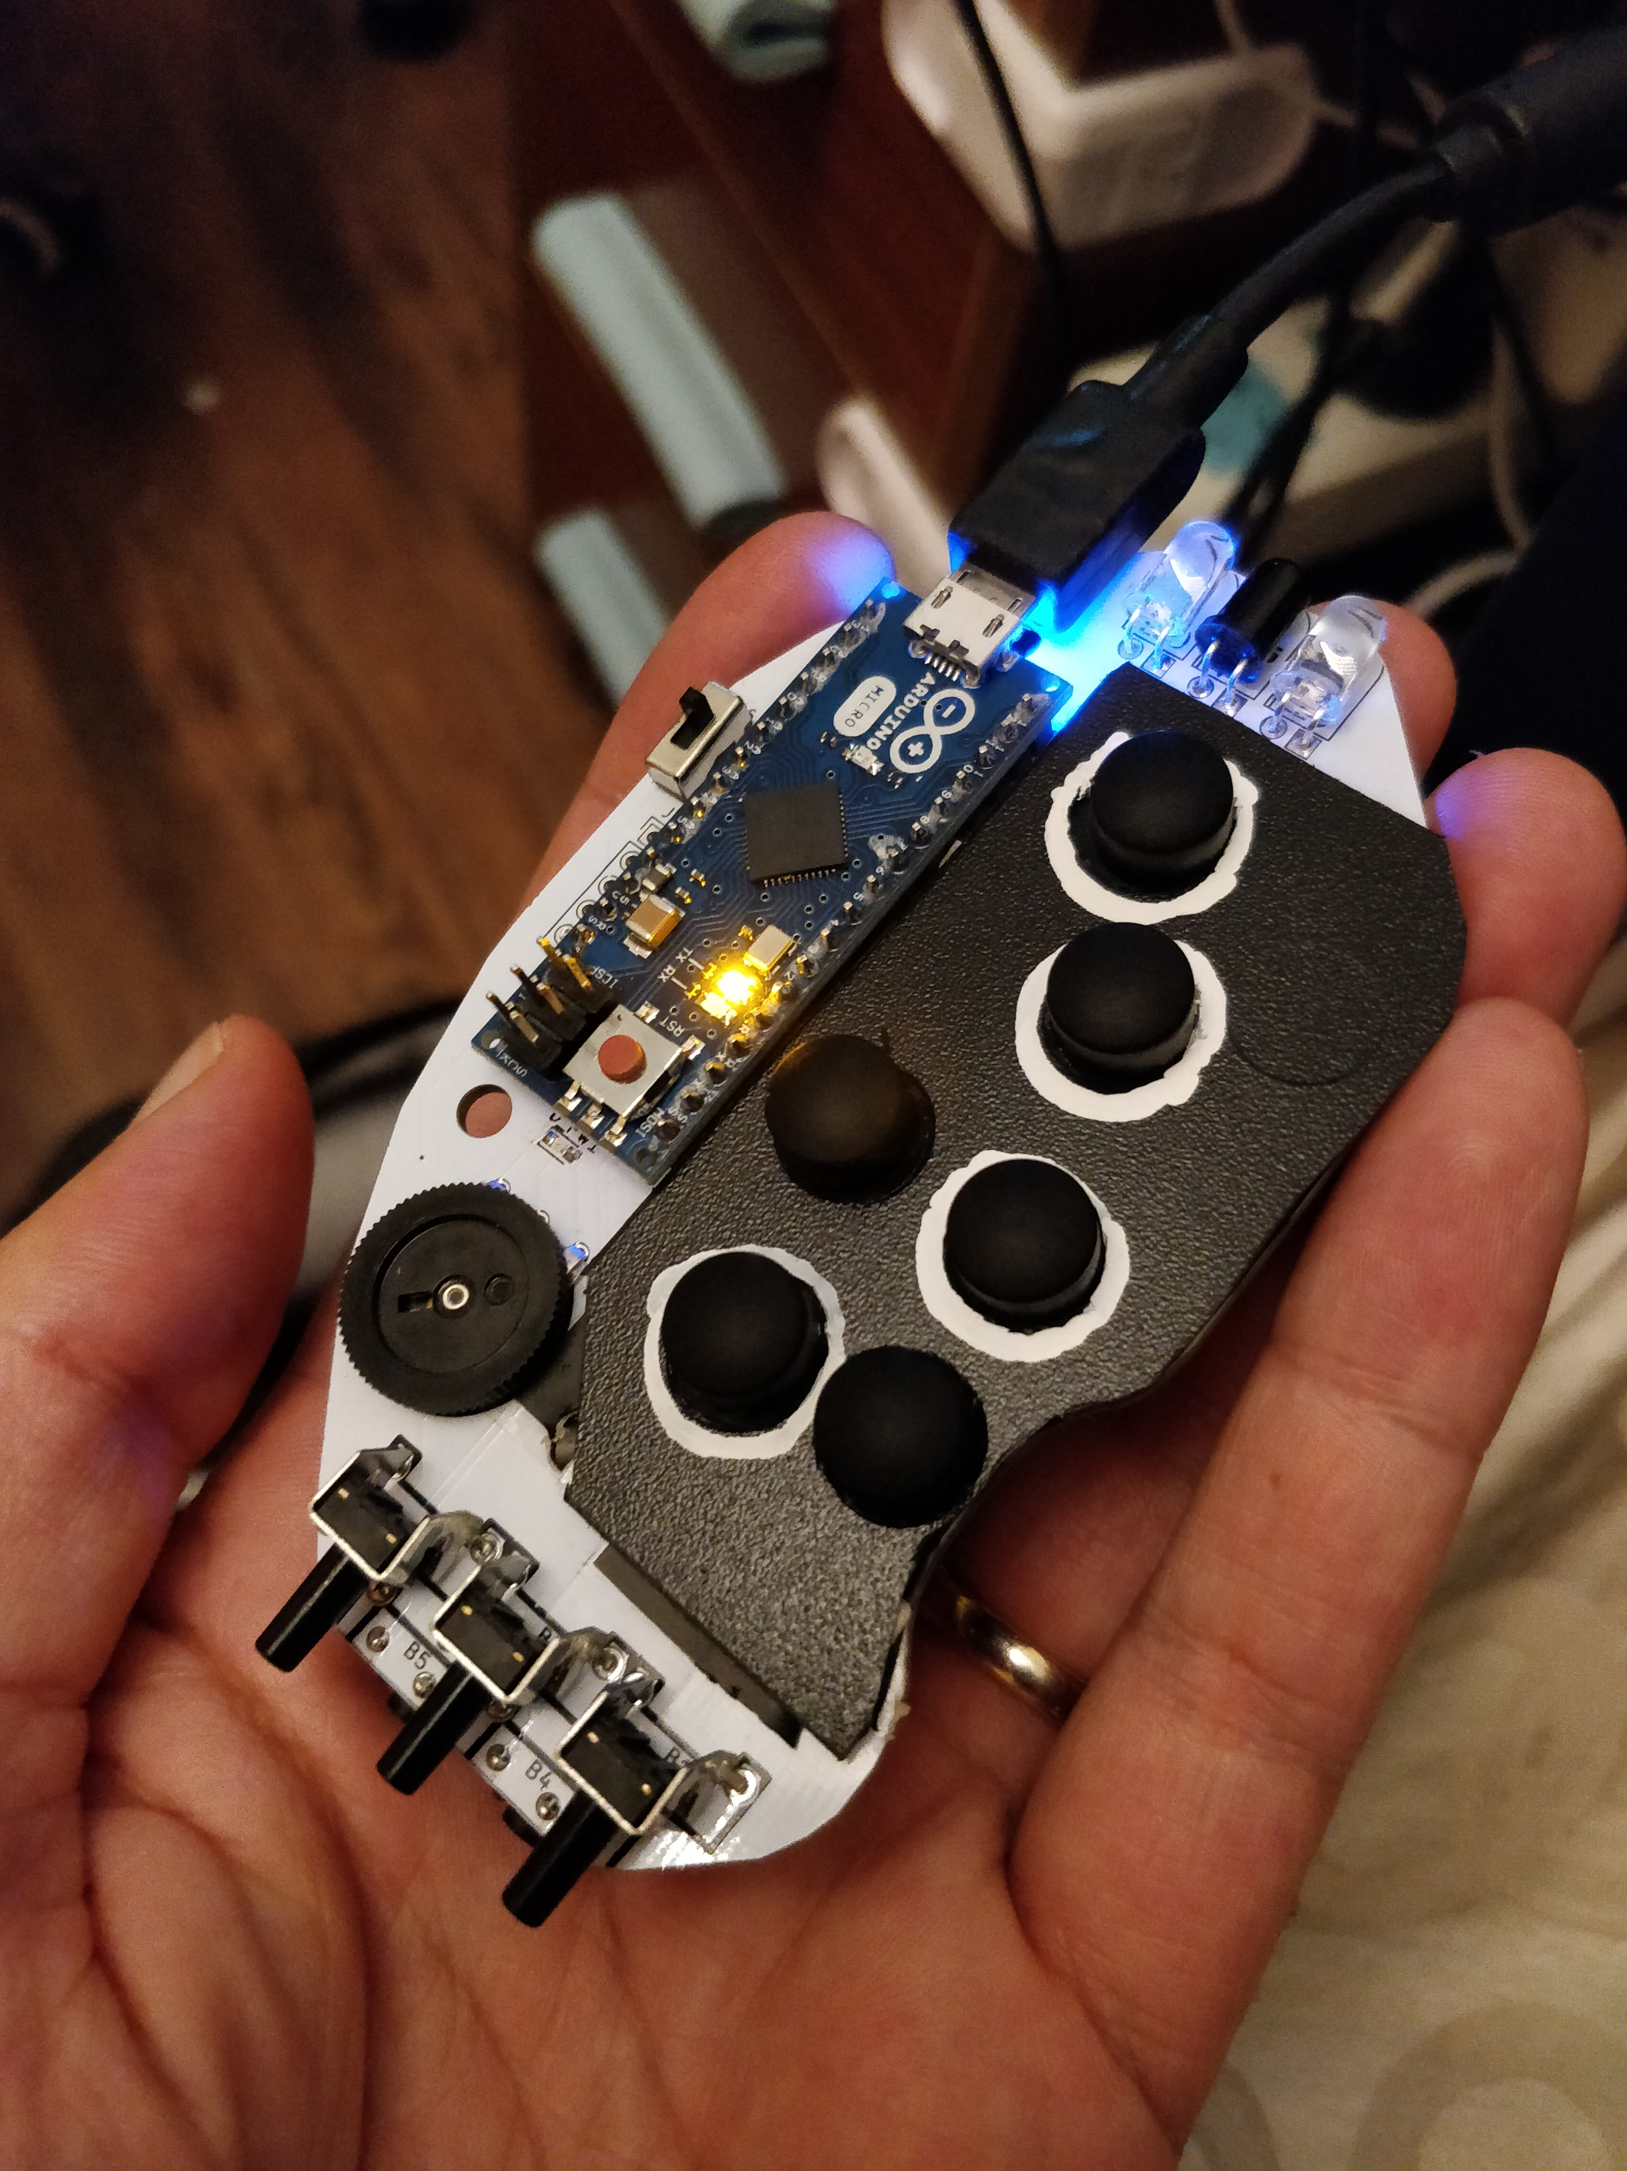
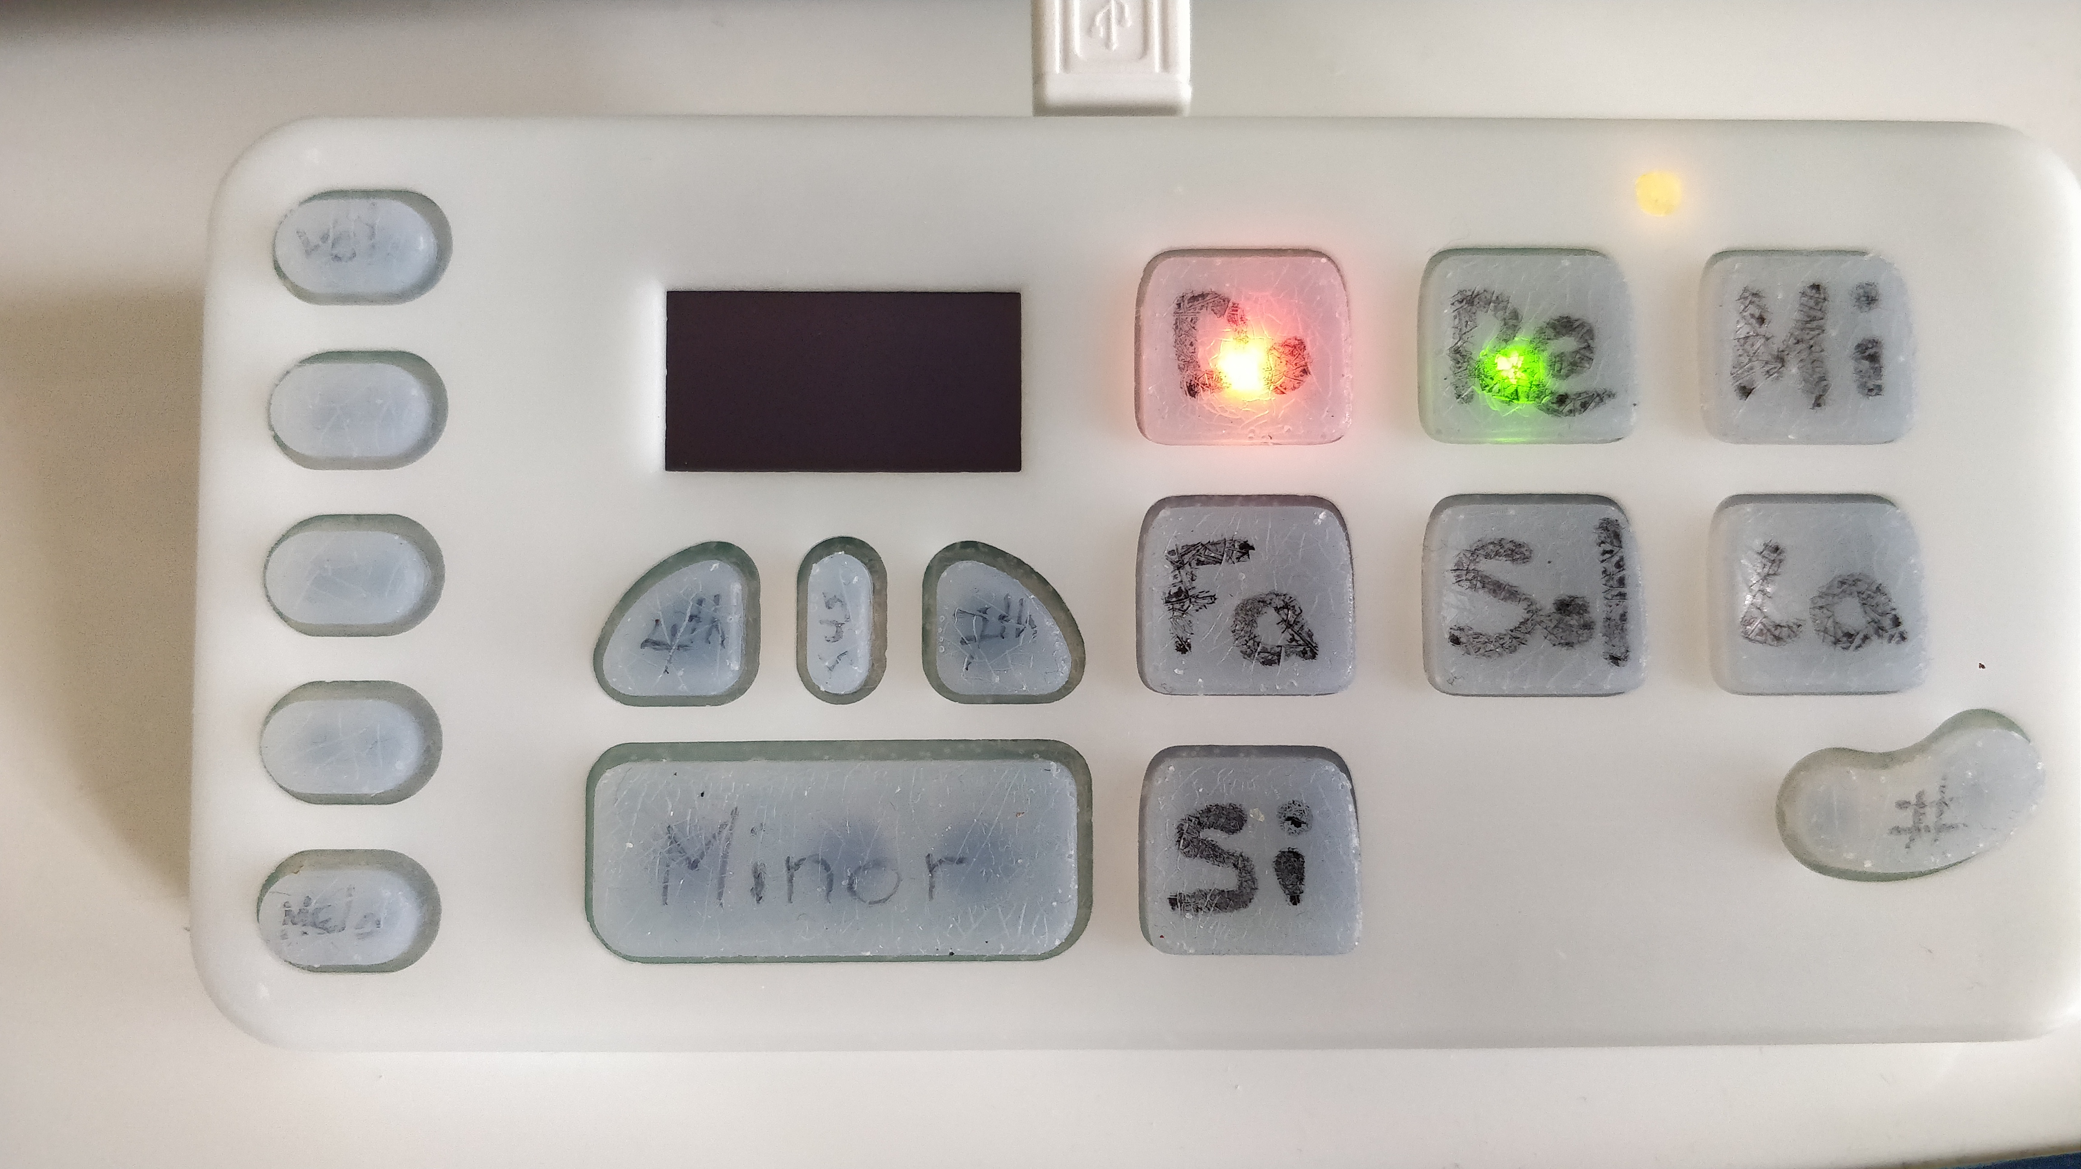
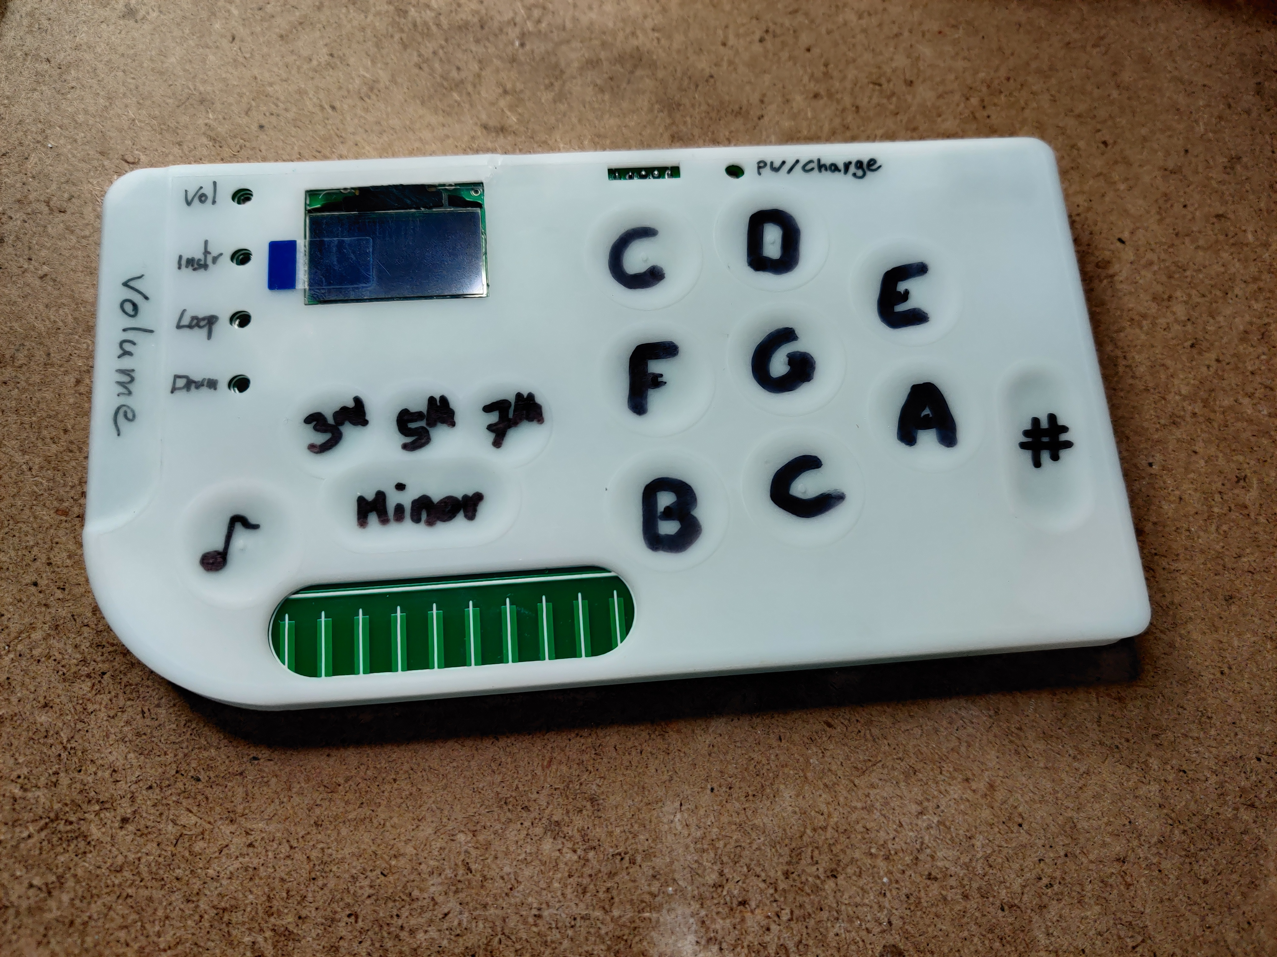
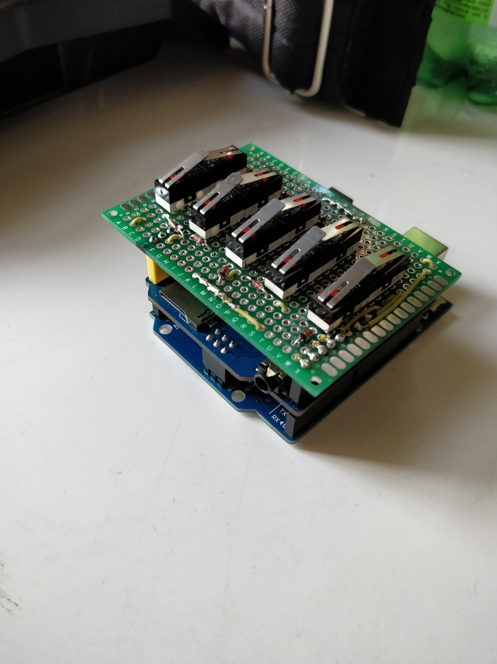
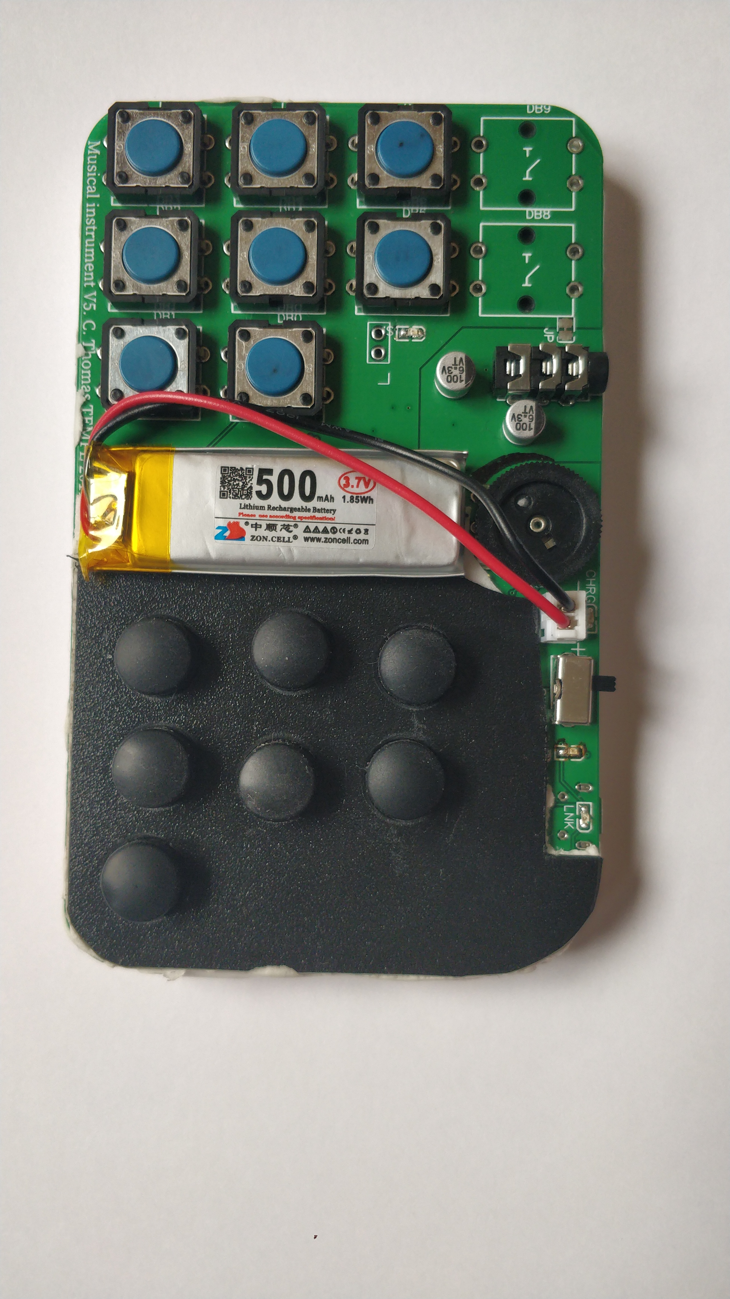
Prototypes
2018
2019
2020
2021

Slide 15
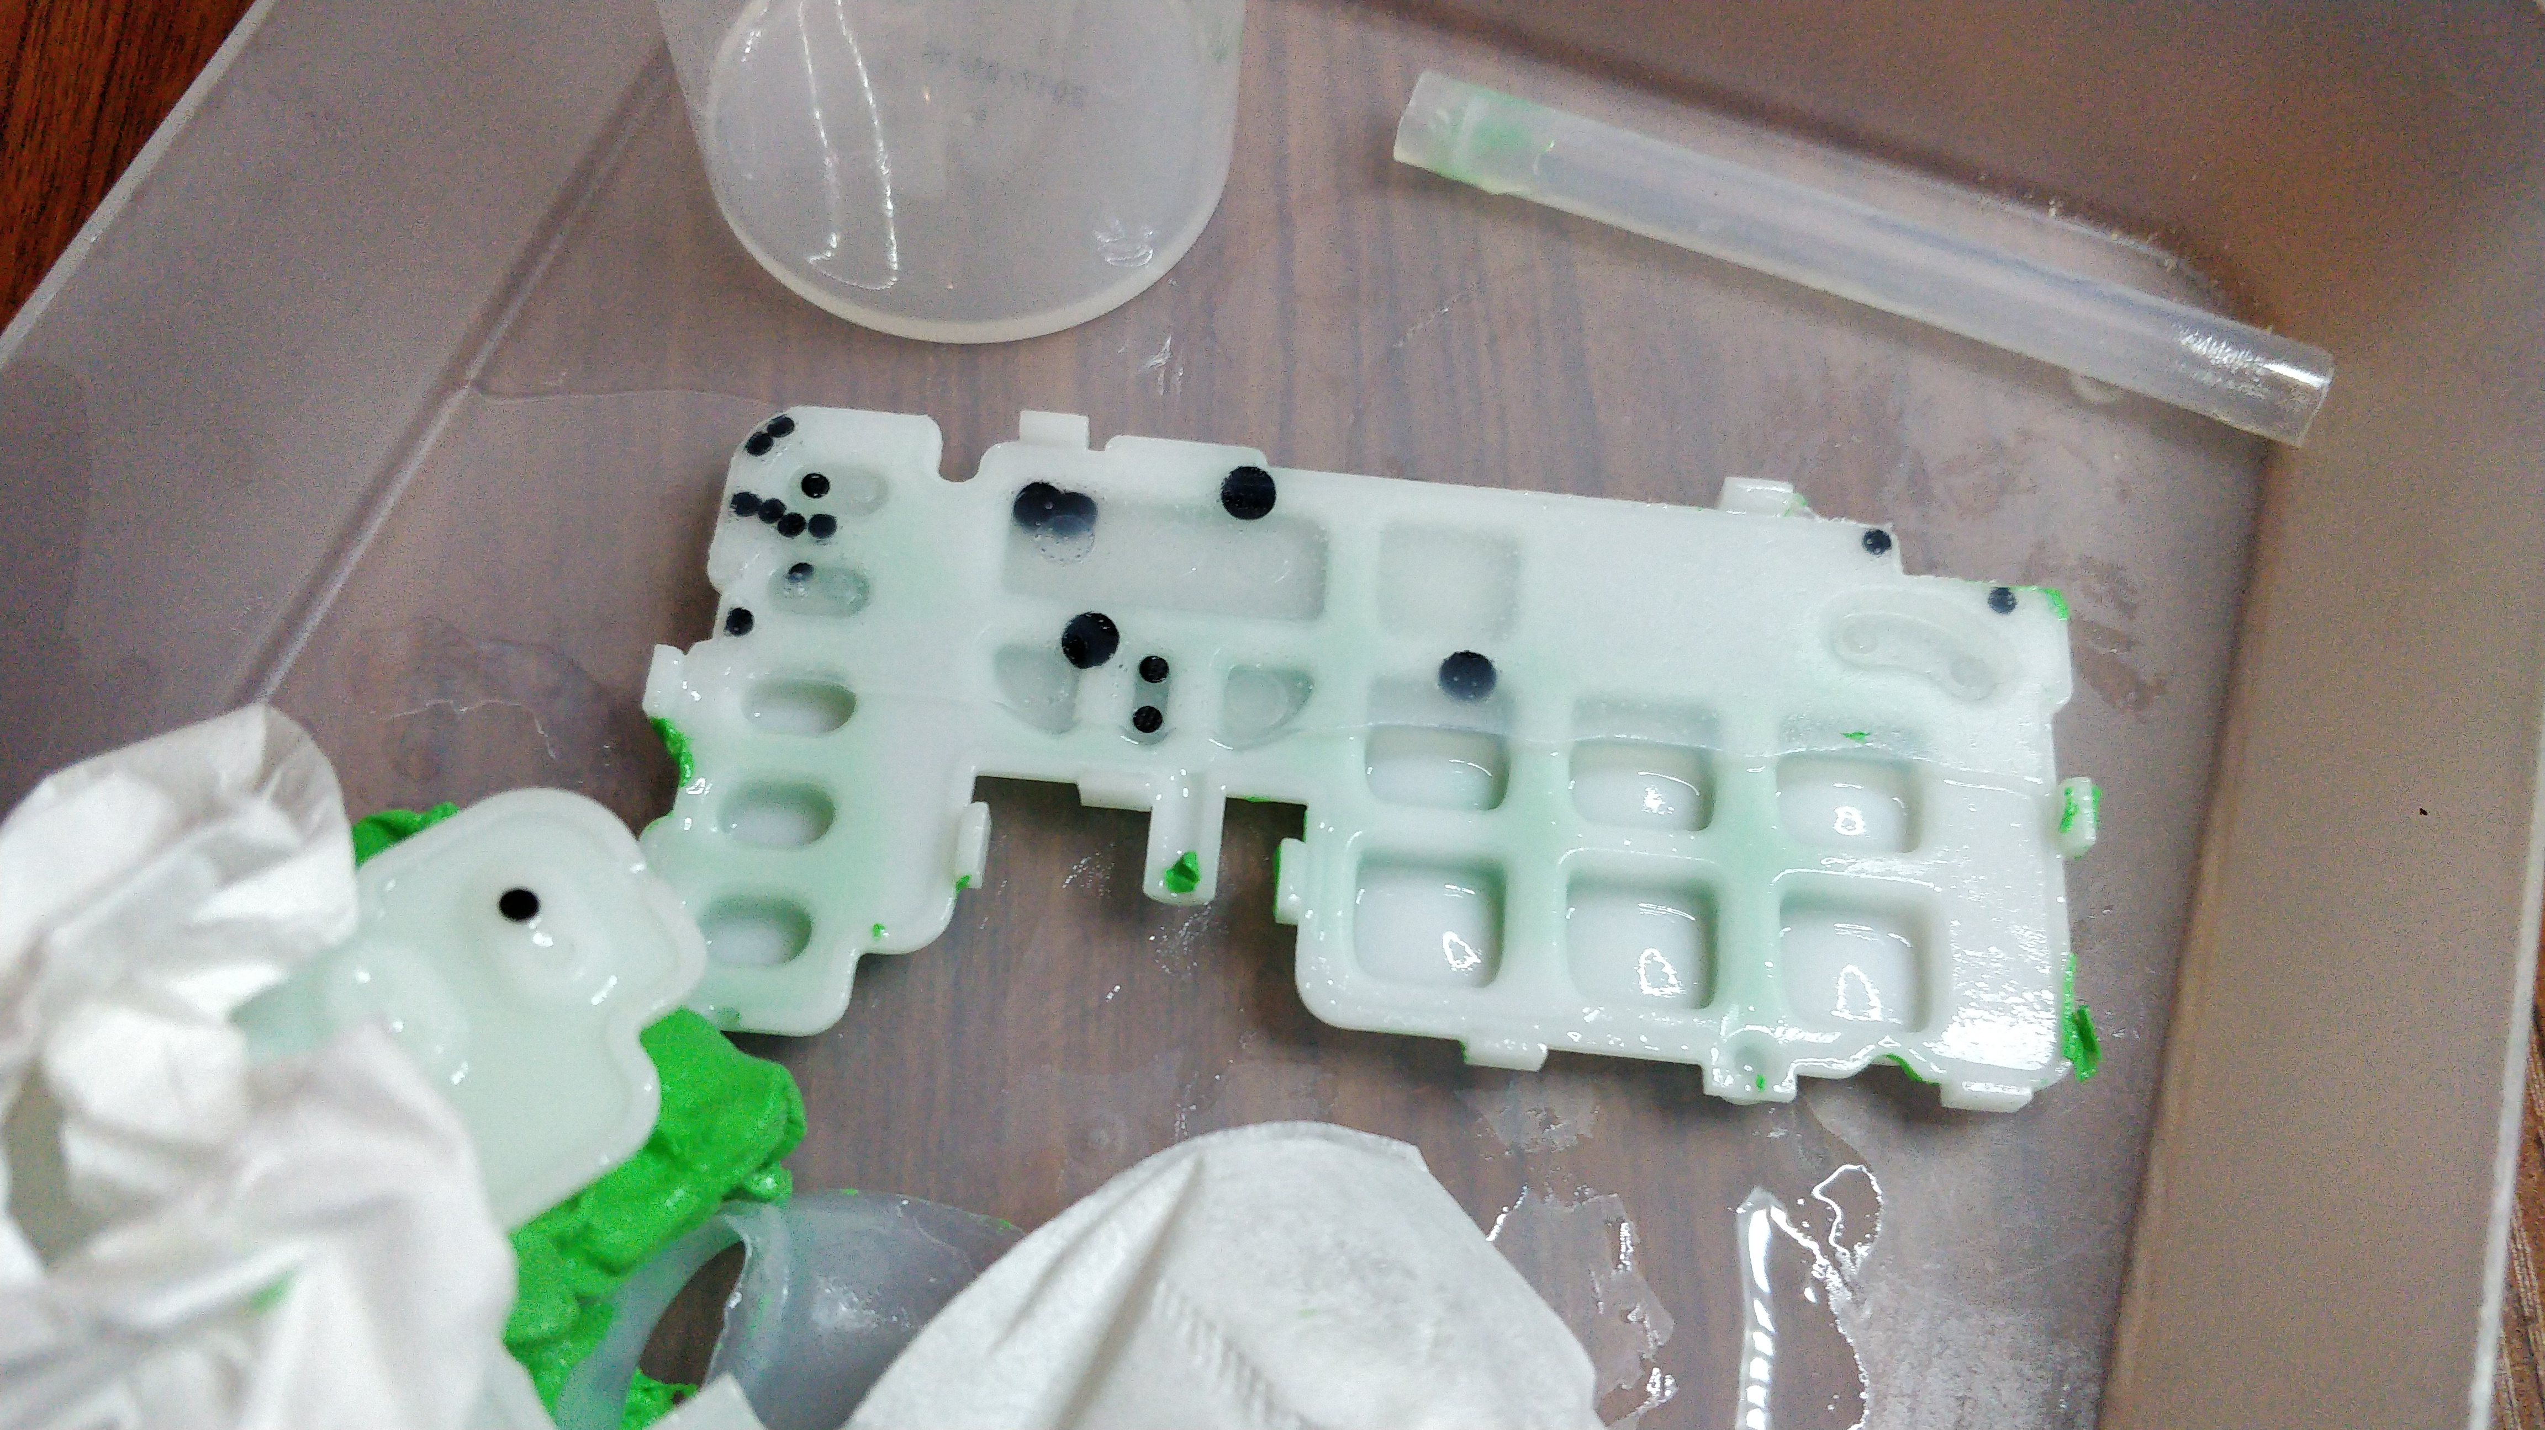
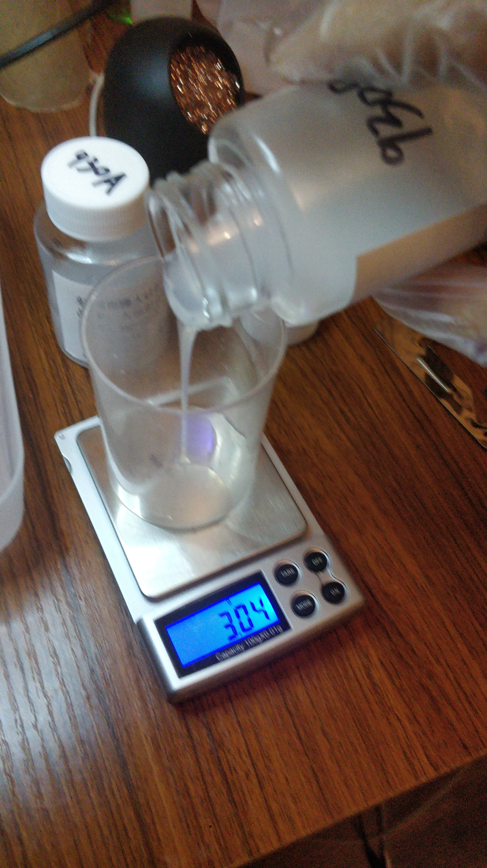
Skills and experiments
PCB design
3D design & printing
Pressure sensitive keys
DIY silicone casting
DIY pad printing
SMT hand soldering

Slide 16
Questions?

